Slide 1

Deploy Your Code Faster Yet Safer
Abel Wang @AbelSquidHead

Slide 2


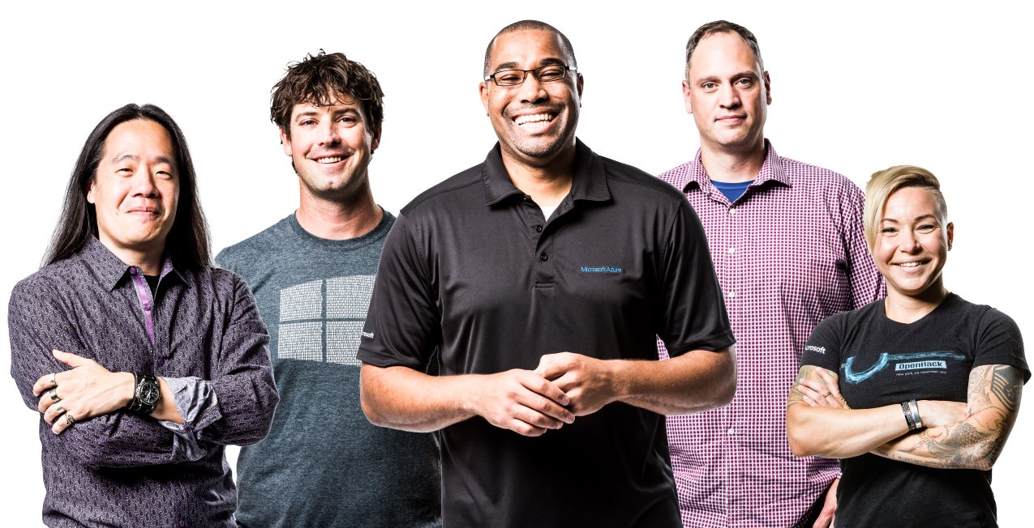

Who am I?
Abel Wang
Senior Cloud Developer Advocate
Blog at abelsquidhead.com
@AbelSquidHead
Work
Writing code for over 20 years
Process Consultant, Certified Scrum Master
ALM Ranger
VSTS Team
DevOps, General App Dev, Visual Studio, Azure
#LoECDA
Fun Stuff
Rock star in his own mind #TheRockstar
Training for the Great Wall Marathon

Slide 3
Who are we?
League of Extraordinary Cloud DevOps Advocates
Cloud Developer Advocates
#LoECDA

Slide 4
DevOps Before and After
A short film

Slide 5

Notes:
DevOps Then and Now

Slide 6

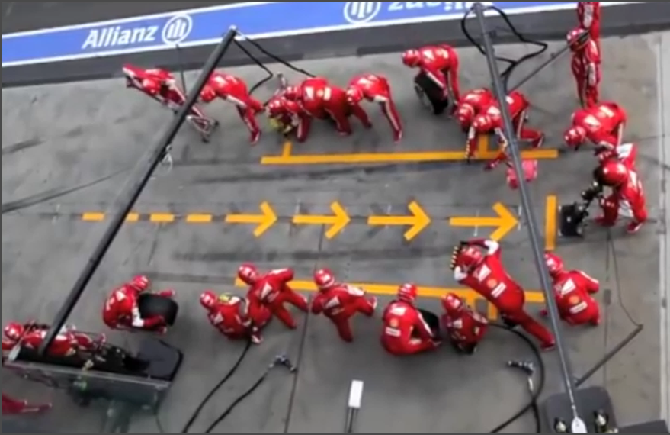
Increase in number of people
Notes:
One comment pointed out that there are many more people in the second pit stop than in the first. I would argue that there are a lot more people involved in delivering software now than even a decade ago. Software delivery has become a team sport involving many more people than ever before. Which I feel is very clear in the video.

Slide 7
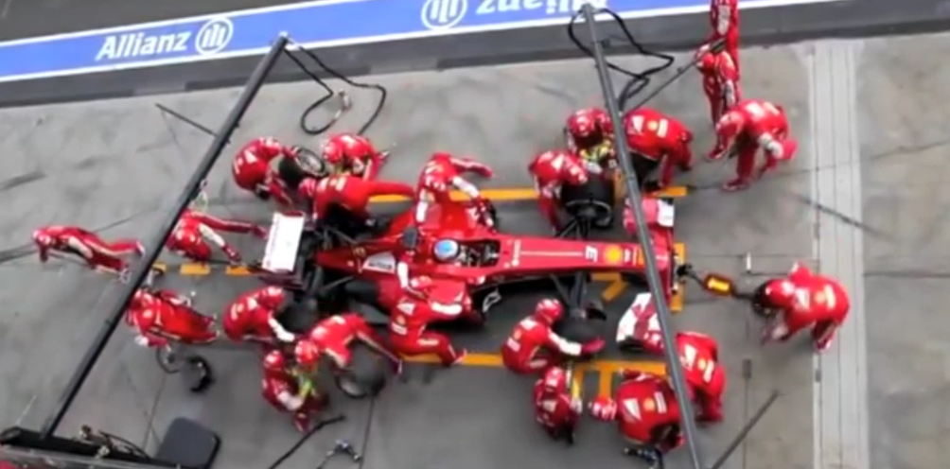
Automation
Notes:
What I also found interesting is when I saw all the additional people I saw them as automated tasks in my head. Specialized tools used to achieve a common goal. They are like micro-services. One service to remove the tire, another to replace it and one service to just jack up the vehicle. I saw and incredibly orchestrated pipeline. I also noticed redundancy built in to the process. If you watch the back of the vehicle there are two people with jacks. One jacks up the back of the vehicle and the other appears to be there just in case. There are also people near the front on the far side that never touch the vehicle but are monitoring the process, so they can learn and improve.

Slide 8
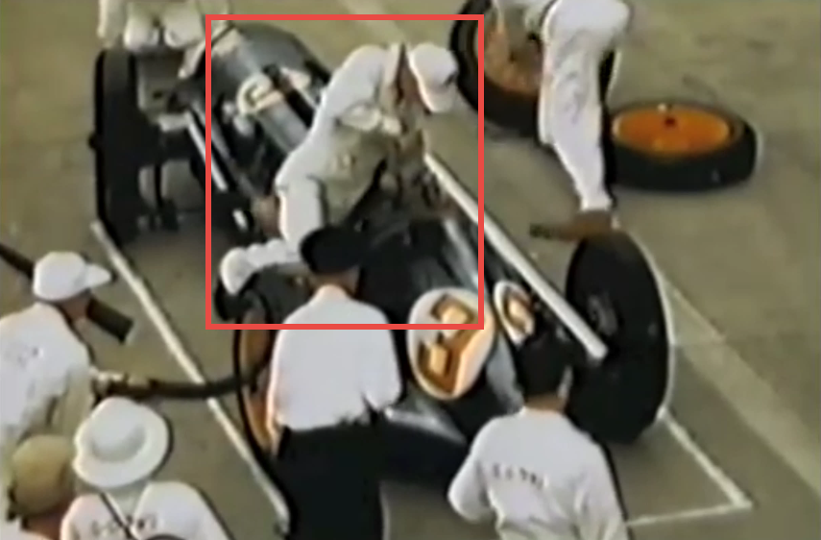
Shift-Left
Notes:
Another comment points out that in the second pit stop the team does not refuel the vehicle. I believe you should fix what hurts most first. Watch the first pit stop again. Refueling the vehicle is done long before the second tire is changed. Reviewing the first pit stop what hurt most was the tire changing. The first pit stop took over 60 seconds the second less than 2. Even if they had refueled the vehicle at the same rat as the 1950’s pit stop that would have been an enormous gain. Not to mention in the second pit stop they changed all four tires and not just two.
I also think it is important to realize that the second team was not required to refuel the vehicle. This means work has already been done to remove the need for the bottle neck by making the vehicles more efficient. We do this in software. Historically manual testing has been the bottle neck, so many teams are leveraging automated tests to reduce the need for manual testing. Applications are being re-architected so the majority of the functionally can be tested and verified in a much more efficient way. This does not remove the bottle neck entirely because at some point manual test might still be run. However, the number of tests should be reduced and therefore the time to execute is reduced as well. Just as in the F1 race eventually the vehicle will need to be refueled but less frequently and quicker because they require less fuel.
The more I watch the video the more I think it is the perfect visualization of a digital transformation.

Slide 9

Shift-Left
Notes:
I also think it is important to realize that the second team was not required to refuel the vehicle. This means work has already been done to remove the need for the bottle neck by making the vehicles more efficient. We do this in software. Historically manual testing has been the bottle neck, so many teams are leveraging automated tests to reduce the need for manual testing. Applications are being re-architected so the majority of the functionally can be tested and verified in a much more efficient way. This does not remove the bottle neck entirely because at some point manual test might still be run. However, the number of tests should be reduced and therefore the time to execute is reduced as well. Just as in the F1 race eventually the vehicle will need to be refueled but less frequently and quicker because they require less fuel.
The more I watch the video the more I think it is the perfect visualization of a digital transformation.

Slide 10
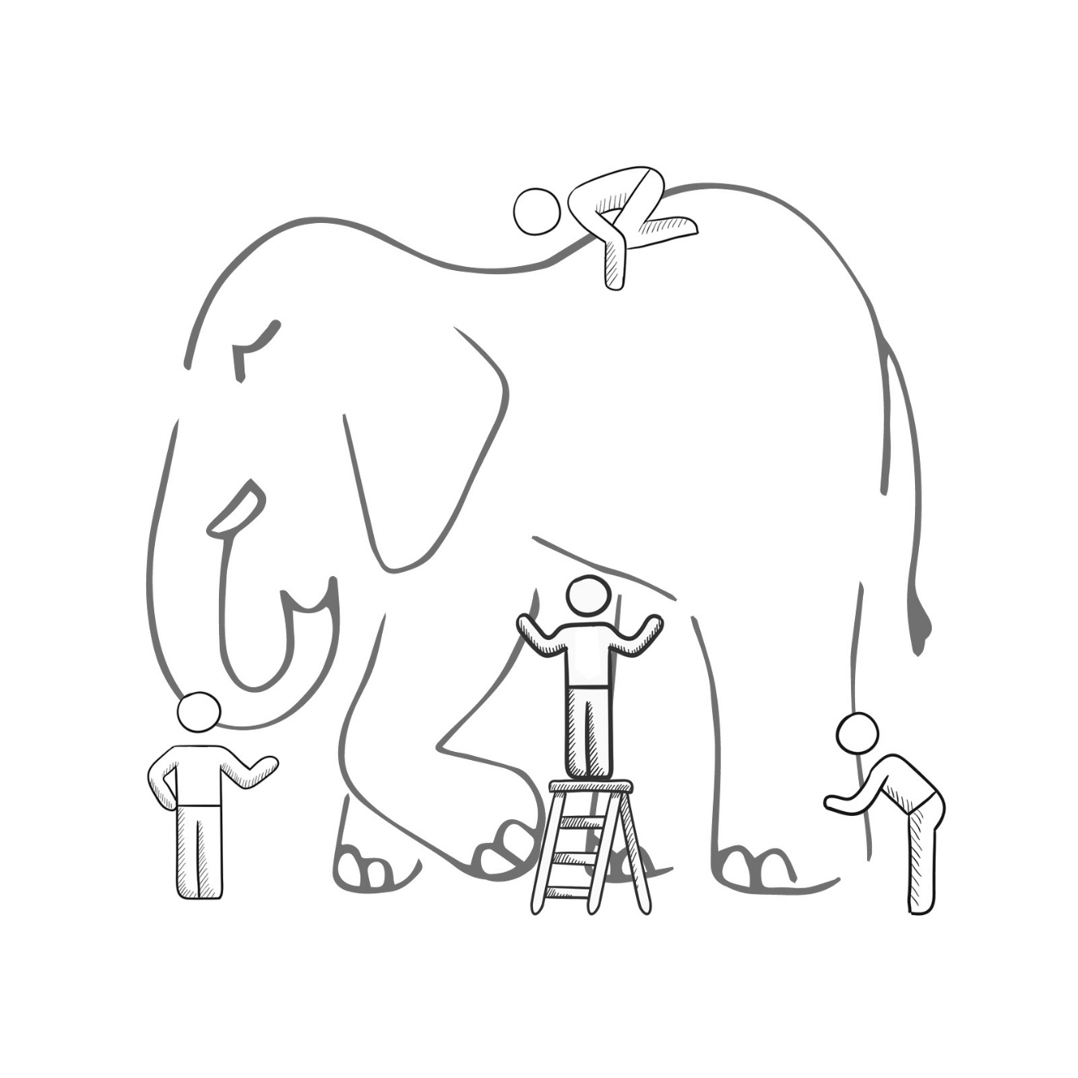
WHAT IS DEVOPS?
It’s a job title
It’s automation
It’s Development and Operations collaboration
It means faster and smaller releases
Notes:
It was – and still is - the time of Agile and DevOps.
We had to formulate a DevOps strategy for our entire organization.
But what is DevOps? It can mean radically different things for different people!

Slide 11


DevOps is the union of people, process, and products to enable continuous delivery of value to our end users.
- Donovan Brown
http://bit.ly/WhatIs-DevOps

Slide 12
Why is DevOps important?
Your competition is already doing this
Increase velocity
Reduce downtime
Reduce human error

Slide 13


High Performance DevOps Companies Achieve…
46x Deployment
Frequency
2,555x Faster Lead
Time For Changes
Faster
Time to Market
DevOps
$
Increased
Revenue
7x Lower Change
Failure Rate
2,604x Faster Mean
Time to Recover
Source: 2018 Accelerate: State of DevOps: Strategies for a New Economy." N. Forsgren, J. Humble, G. Kim. DevOps Research and Assessment (DORA)

Slide 14

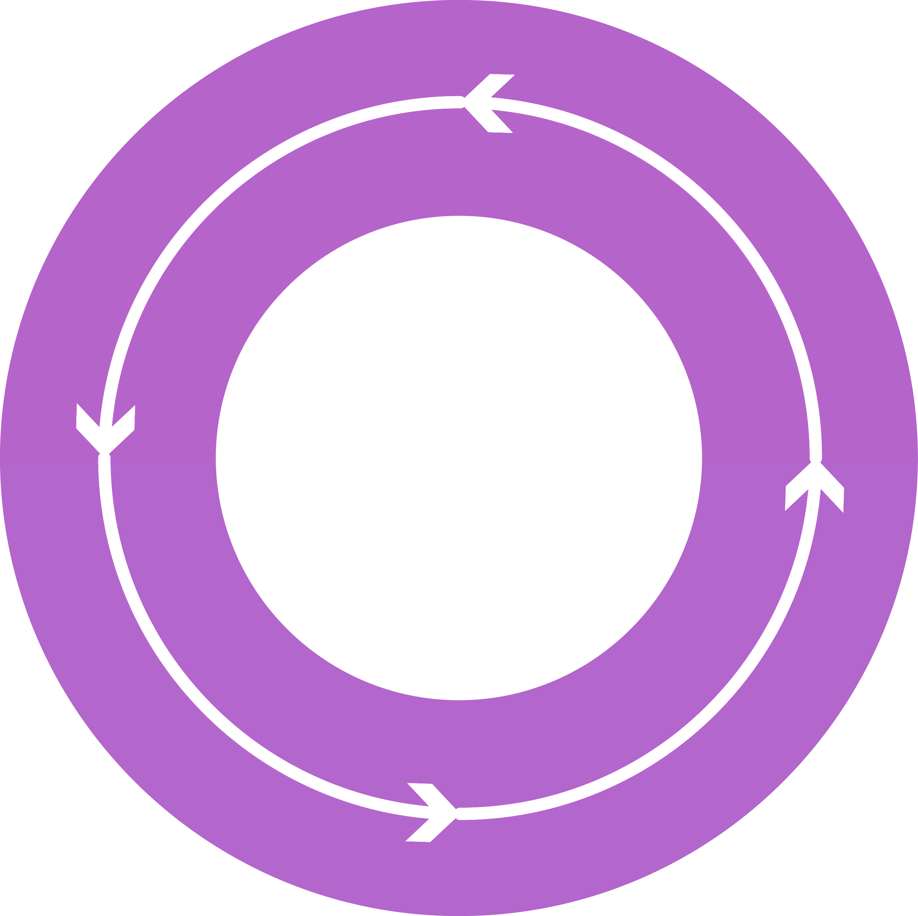




DevOps: the three stage conversation
DEV
OPS
1
People
2
Process
3
Products

Slide 15
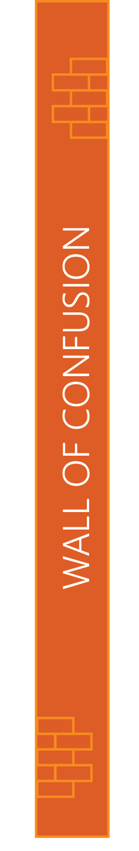

People
DEV
OPS

Slide 16
Process
1
4
Plan
Monitor + Learn
Development
Production
2
3
Develop + Test
Release

Slide 17
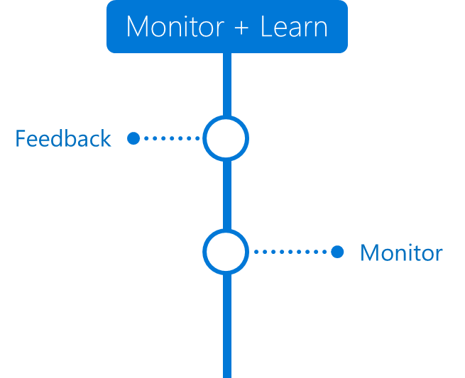

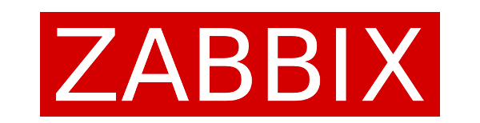
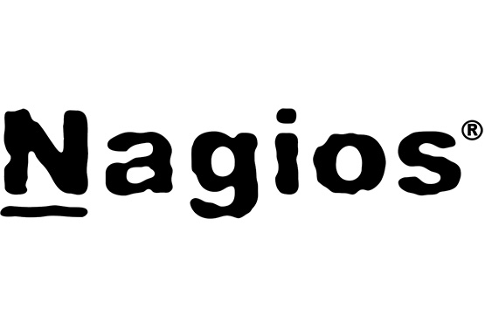

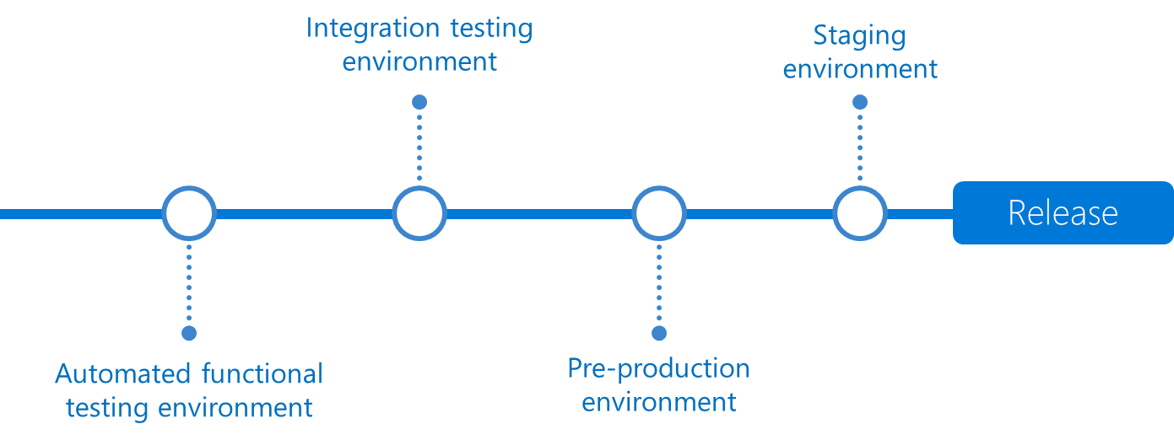
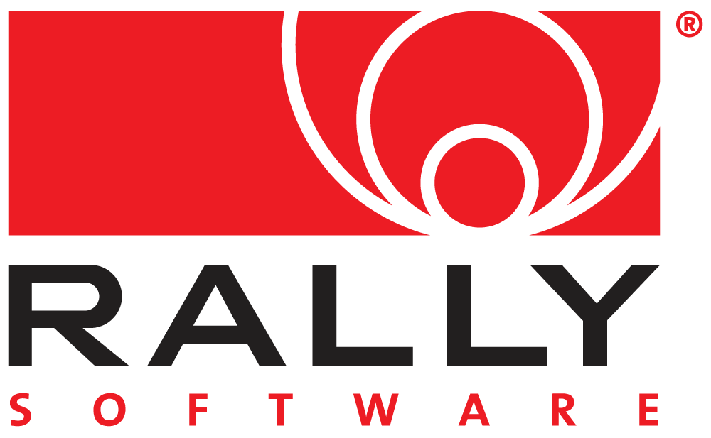
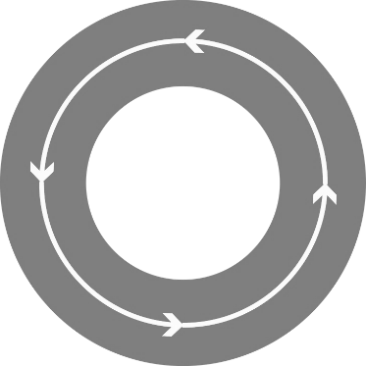

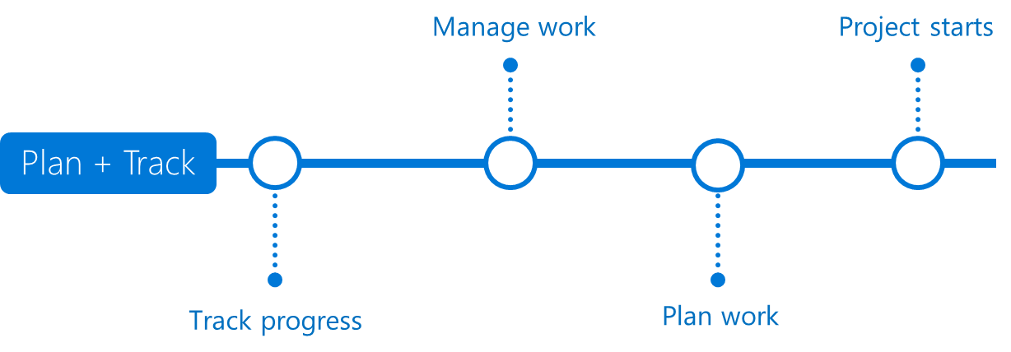

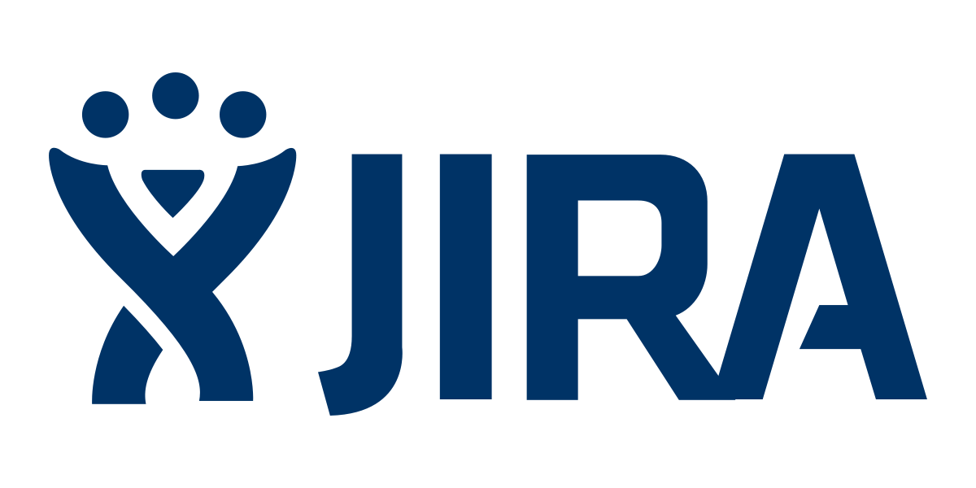
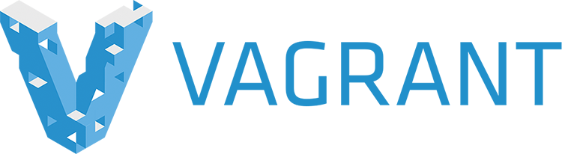





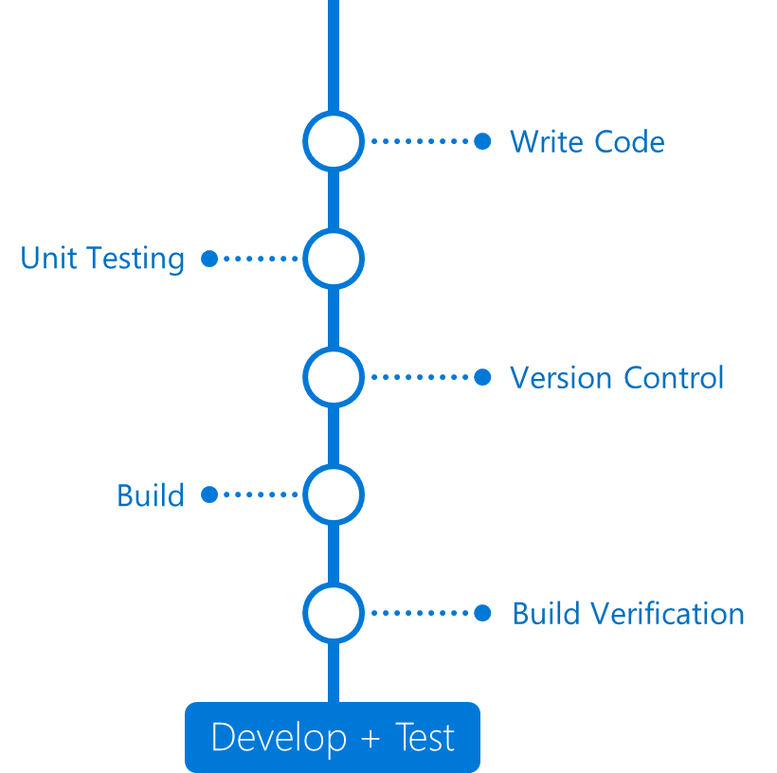
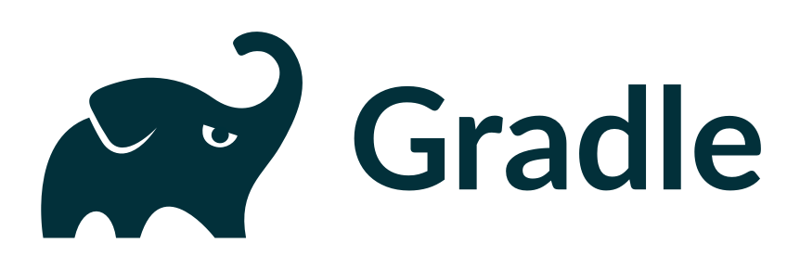
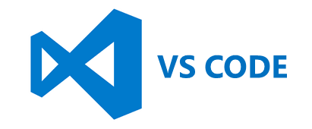
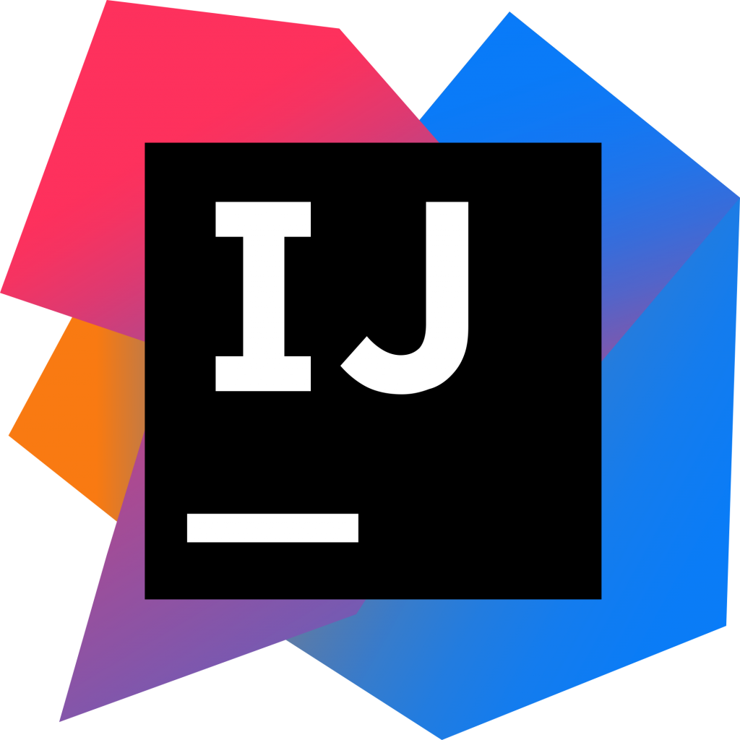

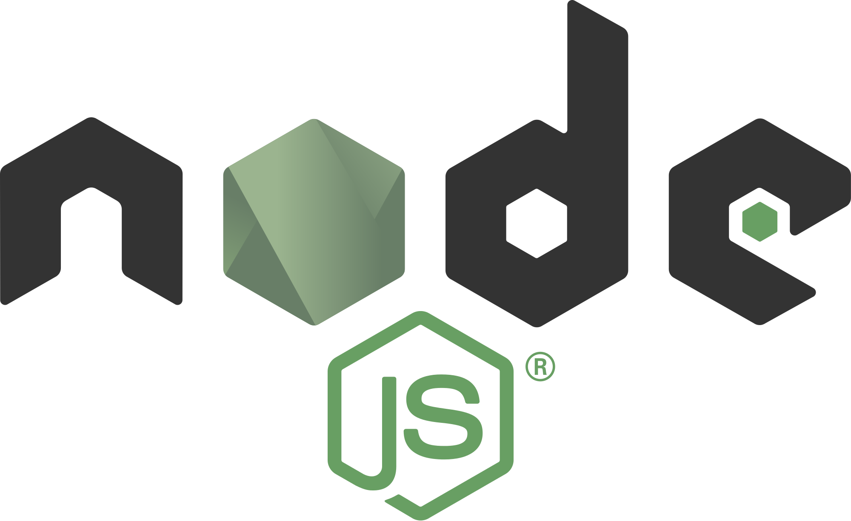
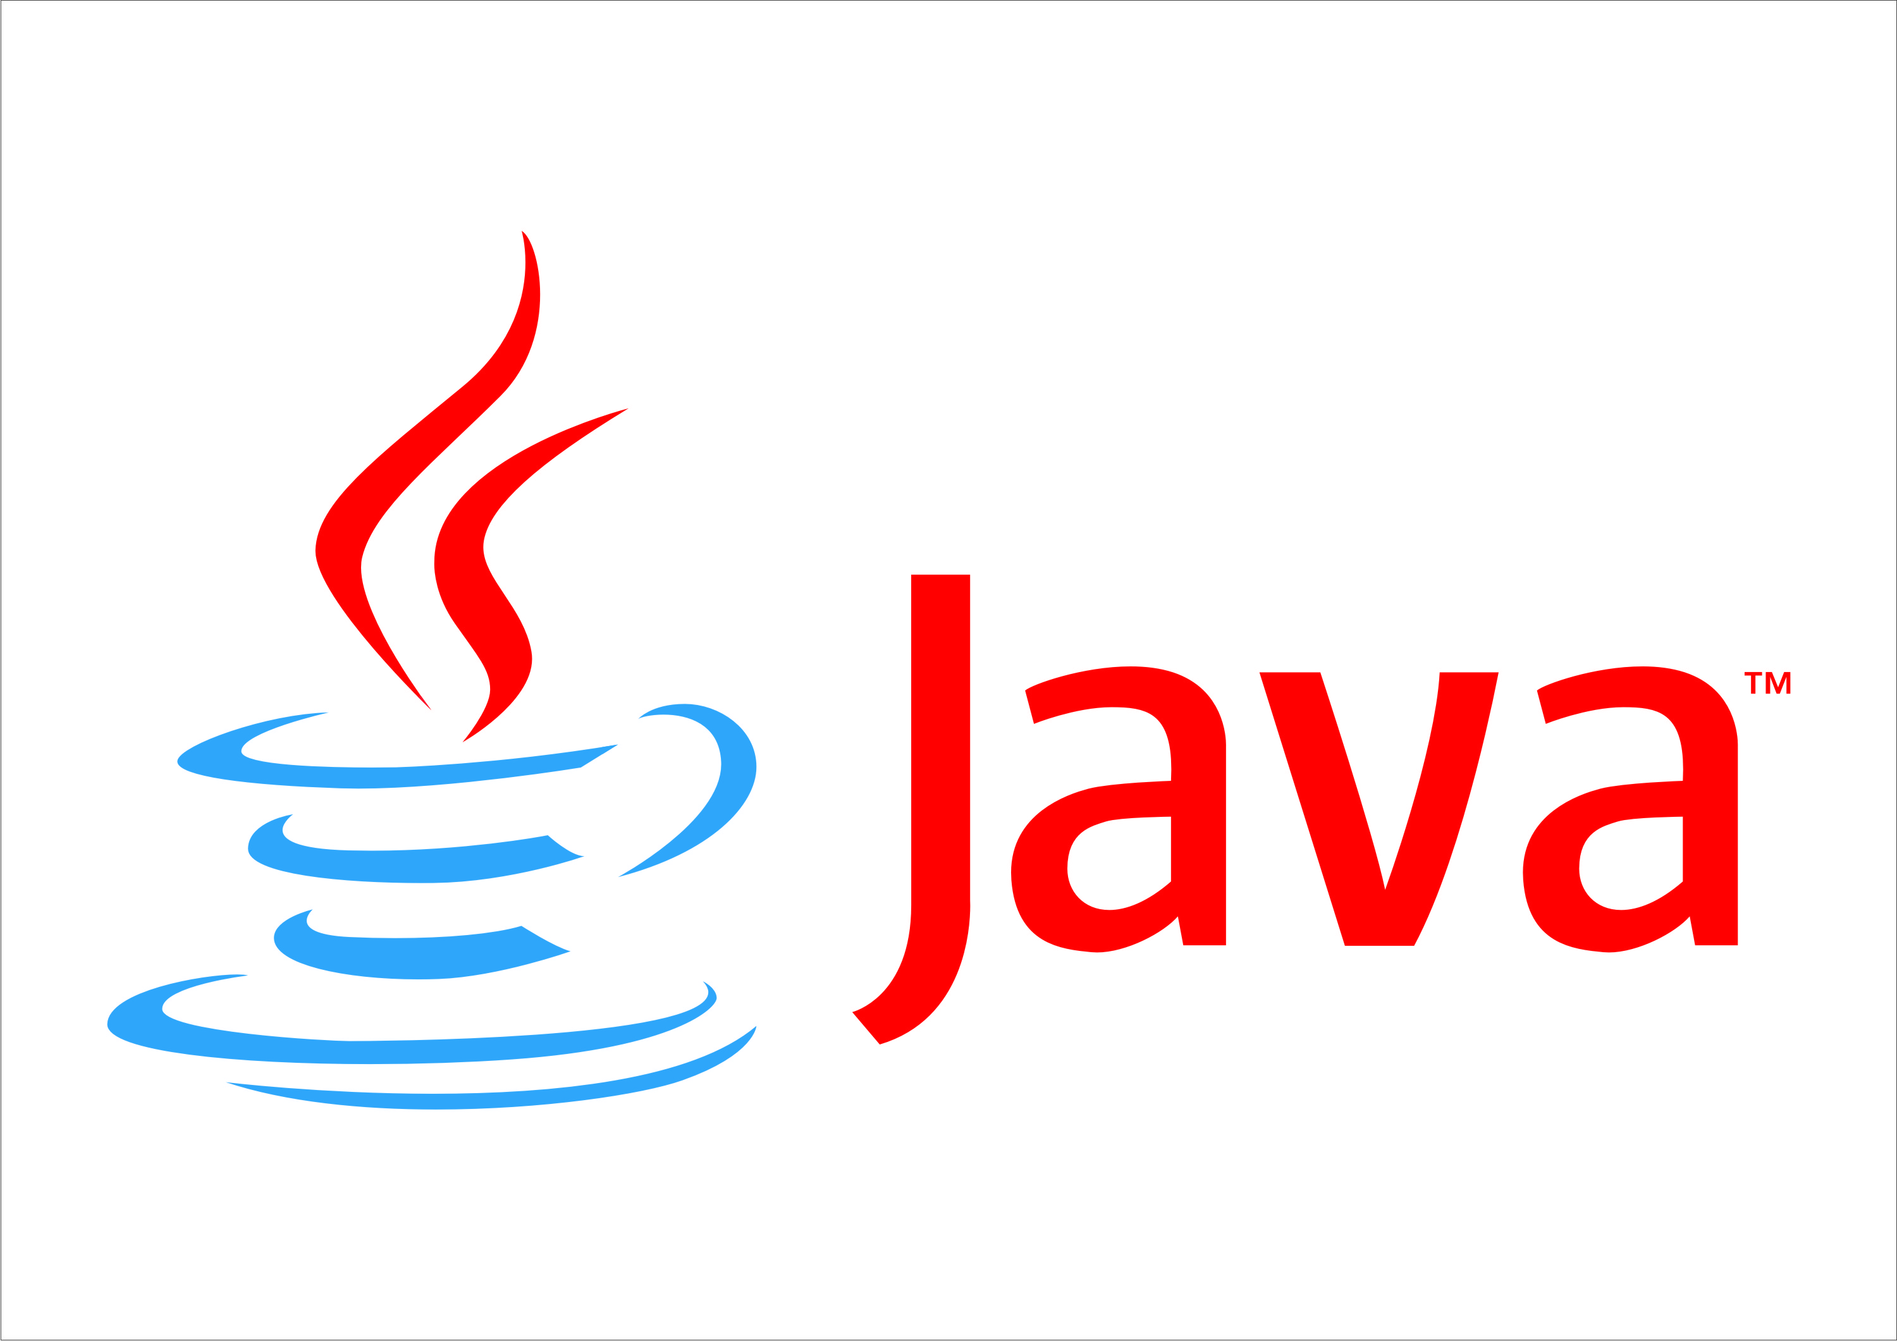

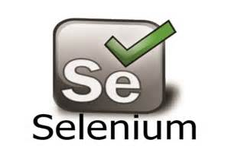
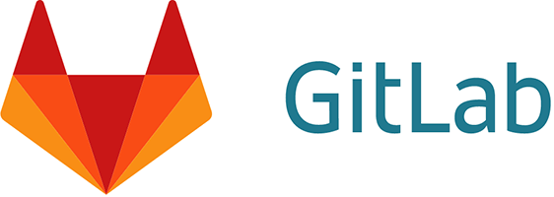


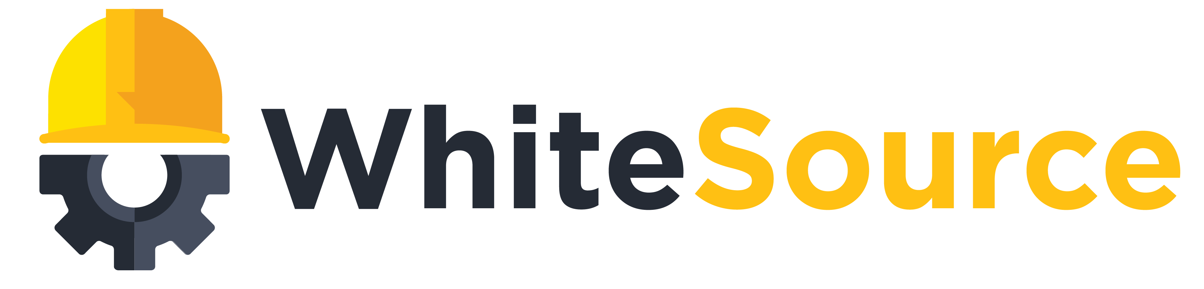
Any Language
Any Platform
DevOps
DevOps
Notes:
Essential DevOps practices include CLICK
agile planning, CLICK
continuous integration, CLICK
continuous delivery, CLICK
and monitoring of applications.
CLICK DevOps becomes reality with powerful tools that help development teams move through the different phases of the DevOps lifecycle quickly and efficiently.
There are many powerful best-of-breed point solutions – both OSS and commercial – available today.
These tools cover individual DevOps tasks or entire phases, and teams choose and integrate their preferred tools in order to get an end-to-end toolchain that works for them.
CLICK Visual Studio Team Services (TS) is our Azure OSS DevOps solution and it is an easy and flexible offering.
It’s enterprise class, integrated from end to end, extensible, and works with other tools.
It ties everything together – program in any language, develop on any operating system, and deploy to any platform.
It’s best with Azure, but it integrates with other cloud providers, giving users the flexibility to explore and gradually move to Azure.
We do not ask you to stop promoting your favorite OSS DevOps tools – quite the opposite, we want your customers move the tools they are using to Azure.
However, we do want you to keep in mind that TS is a great integration platform that can work with your OSS tool of choice and also brings additional value if you include it as part of an existing OSS DevOps setup.
How? Let’s take Jenkins as an example.
Jenkins is a great tool and best-of-breed OSS solution. Jenkins runs on Azure, in fact you can provision a fully functional Jenkins instance in just a few minutes from the Azure portal. That’s a great start and will create some consumption.
But Jenkins also has some drawbacks from past experience:
Managing Jenkins infrastructure can be cumbersome. It requires a master/slave relationship between all build nodes. As a team grows, they will require more builds which in turns requires more build nodes. From an infrastructure perspective, you need a dedicated team to manage that whole setup to ensure it runs smoothly.
Security within Jenkins is enforced via plugins and highly complex to setup (when compared to TS).
The plugin ecosystem is wide but there a lot of plugins that cause stability issues within Jenkins.
Upgrading Jenkins is very painful which results in more teams using outdated version of Jenkins which can cause security risks.
Integrating Jenkins with other tools like Jira or Github is cumbersome (while TS provides features from all tools within one product).
If a Jenkins setup is mission-critical then setting up Jenkins in HA is extremely hard considering its backend is a filesystem rather than a database. Consequently, teams will tend to scale the Jenkins master vertically instead of horizontally as the number of jobs increases. The on-premises team is responsible to provide a decent SLA to the dev/ops teams.
This is not to say that teams should stop using Jenkins – but they should be aware how TS can help mitigate some of the drawbacks.
This was just an example of one tool in an end-to-end DevOps toolchain.
If your customer is using multiple different tools, similar issues will crop up.

Slide 18





Introducing Azure DevOps
Azure Boards
Azure Pipelines
Azure Repos
Deliver value to your users faster using proven agile tools to plan, track, and discuss work across your teams.
Build, test, and deploy with CI/CD that works with any language, platform, and cloud. Connect to GitHub or any other Git provider and deploy continuously.
Get unlimited, cloud-hosted private Git repos and collaborate to build better code with pull requests and advanced file management.
Azure Test Plans
Azure Artifacts
➔
Test and ship with confidence using manual and exploratory testing tools.
Create, host, and share packages with your team, and add artifacts to your CI/CD pipelines with a single click.
https://azure.com/devops
Notes:
So does TFS

Slide 19

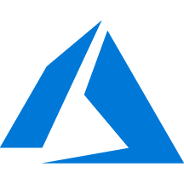
Azure DevOps + Azure

Slide 20
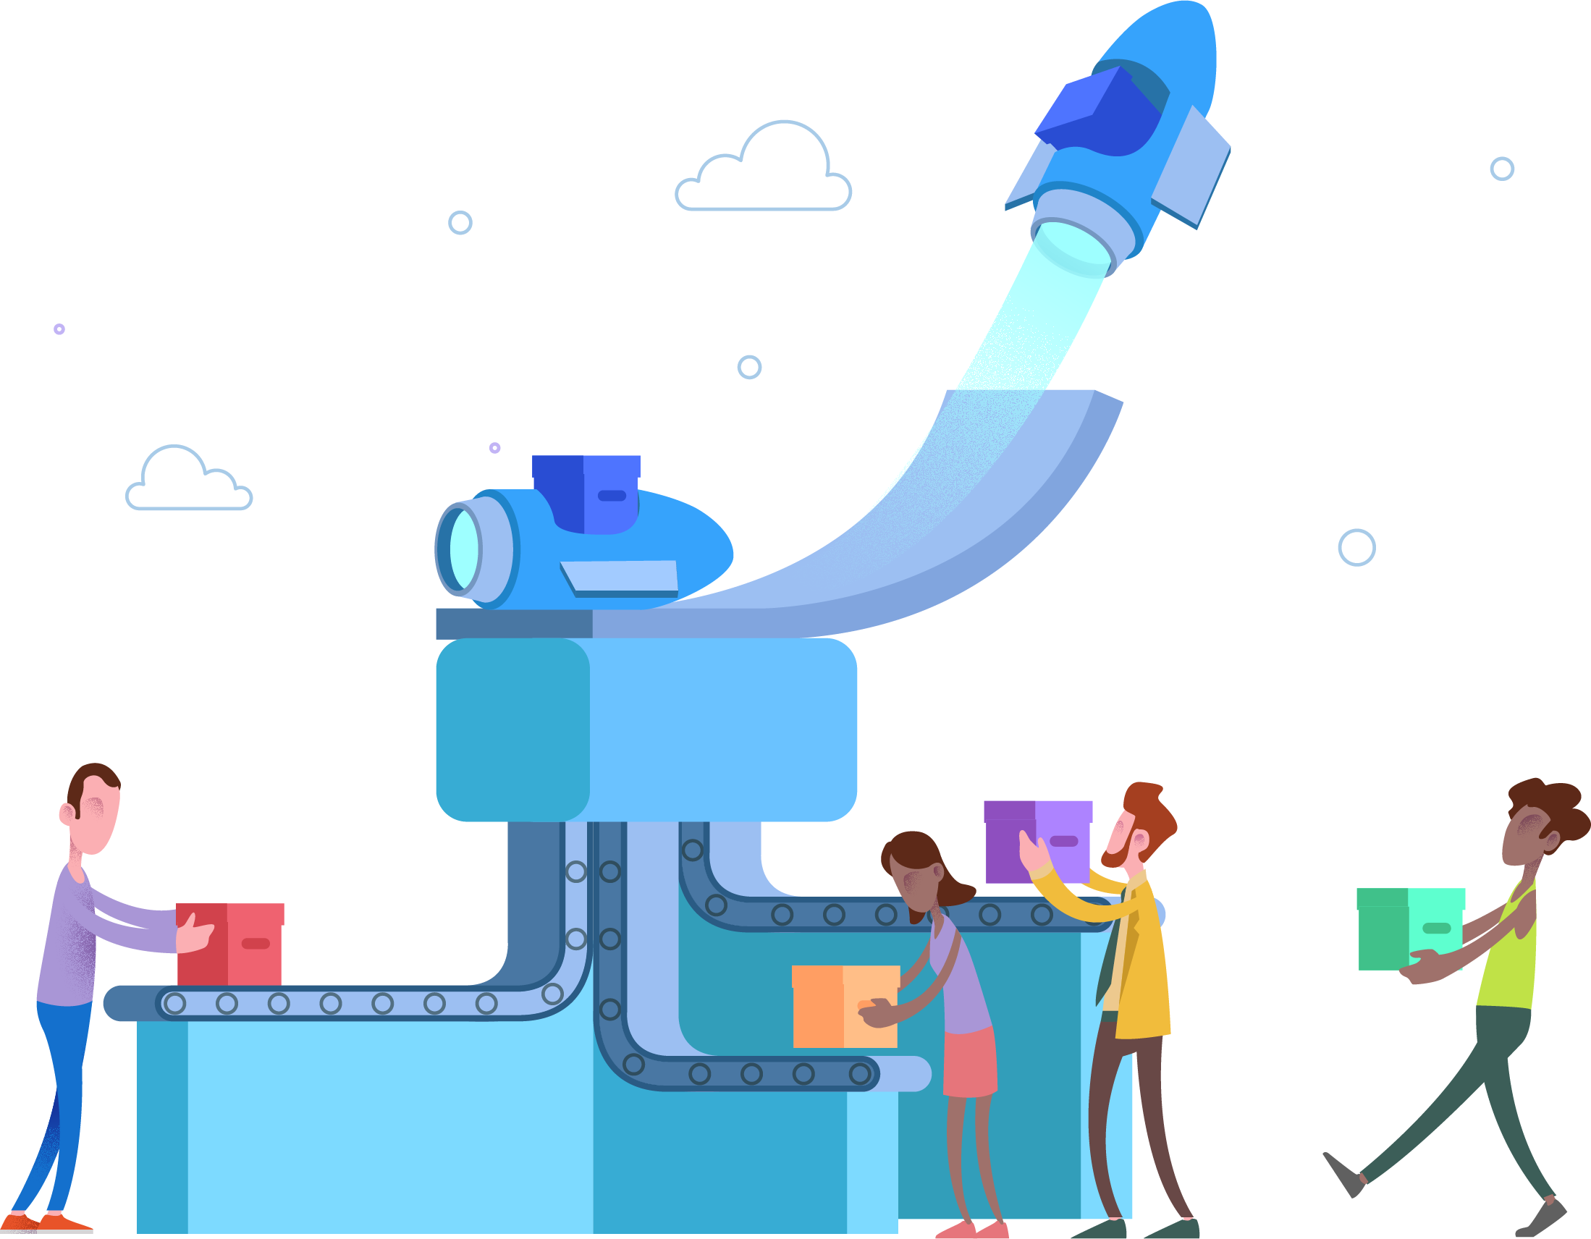



Azure DevOps
#AzureDevOps
https://azure.com/devops
@AzureDevOps
https://aka.ms/AzureDevOpsForum
https://aka.ms/DevOpsBlog/
Notes:
Join the conversation.
Potentially replace for speaker contact details / intro.

